Slide 1
EVOLUTIONARY HISTORY OF TMEM216 PROTEIN
Samet Mert -23511
Dila Karataş -28852
Nil Özde Özgen -30802
Türkan Doğa Gizer - 29072
Mehmet Barış Tekdemir -29068

Slide 2
Outline
Recap
Introduction
Tools & Methods
Results
Discussion
Issues
References

Slide 3
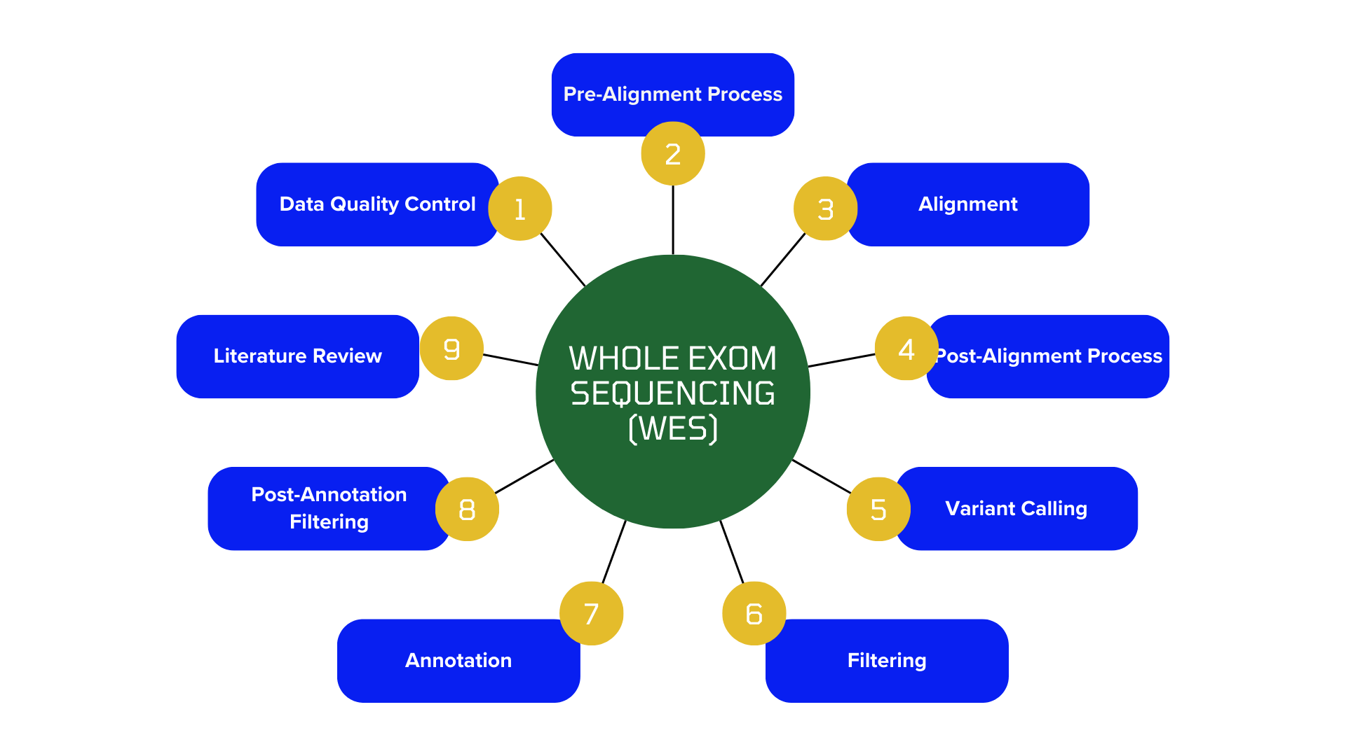
Recap
Notes:
BURDA BENCE SADECE ADIMLARI SÖYLESEN YETER. ZATEN COMMANDLER FALAN GITHUB DA VAR. AMA ŞEYİ SÖYLEYEBİLİRSİN BİZ İLK KISIMDA VARIANT CALLING DE BIRAKMIŞTIK. ONU YAPAMAMIŞTIK YANİ. ORDAN DEVAM ETTİK. EN SON DA LİTERATÜR TARAMASI İLE TMEM216 GENİNİ SEÇMEYE KARAR VERDİK.

Slide 4
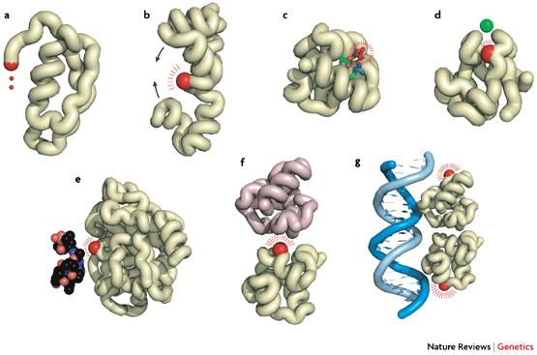
Mutations in Proteins
– Errors in the Binding Process.
– Rare Diseases.
Notes:
PRTOEİNLERİN MUTASYONA UĞRAMASI, ORGANİZMANIN GENETİK MATERYALİNİN BOZULMASI DEMEKTİR. GENLERİN MUTASYONA UĞRAMALARI KODLADIKLARI PROTEİNLERİN YAPISINI VE FONKSIYONUNU ETKILEYEBILIR. BU DA NORMAL HÜCRESEL FONKSİYONLARI BOZARAK VÜCUTTA ÇEŞİTLİ HASTALIKLARA SEBEP OLABİLİR. BU MUTASYONLAR PATOJENİK VE NÖRT OLABİLİRLER. BU PROJE KAPSAMINDA DA TMEM216 GENİNDE MEYDANA GELEN MUTASYONLARIN PATOJENİTELERİ İNCELENMİŞTİR.

Slide 5
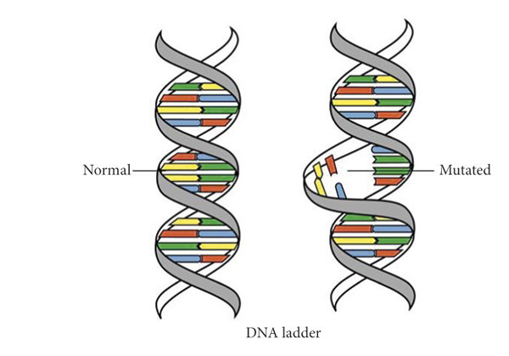
Why TMEM 216 ?
About 150 mutations in proteins:
Genes with mutations → Fatal Diseases.
Genes with mutations → Not Fatal Diseases.
Genes with mutations → Not Fatal Disease, but Fatal Complications.
According to Pathogenicity:
→ Elimination and Analysis.
→ NPHP4 → TMEM 216 → Joubert Syndrome 2.
Notes:
BURDA BİZ PROJENİN DEVAMI İÇİN TMEM216 GENİNİ SEÇTİK. POST FILTRATIONDAN SONRA ELİMİZDE 148 TANE GEN VARDI. HEPSİ İÇİN LİTERATÜR TARAMASI YAPTIK TEK TEK VE GENLERİ 3 FARKLI GRUPTA SIRALADIK. ÖLÜMCÜL BİR HASTALIKLA RELATED OLANLAR, KENDİSİ DİREK ÖLÜMCÜL OLMAYAN AMA YAN ETKİLERİ ÖLÜMCÜL OLABİLEN HASTALIKLARLA İLİŞKİLİ OLANLAR VE DİREK ÖLÜMCÜL OLMAYAN HASTALIKLARLA RELATED OLANLAR OLARAK. 16 TANE ÖLÜMCÜL GEN BULDUK BUNUN SONUNDA VE BU 16 GENİ TEK TEK LİTERATÜR TARAMASI İLE RELATED OLDUKLARI HASTALIKLAR ÜZERİNDEKİ PATOJENİTELERİNE GÖRE SIRALADIK. İLGİLİ OLDUĞU HASTALIĞA SEBEP OLMA ORANI EN YÜKSEK OLAN GEN TMEM216 OLARAK BELİRLENDİ. BU GENDEKİ MIUTASYONLARIN BİRİNCİL OLARAK NEDEN OLDUĞU HASTALIK DA JOUBERT SYNDROME 2 OLARAK BELİRLENDİ.

Slide 6
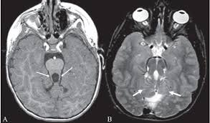
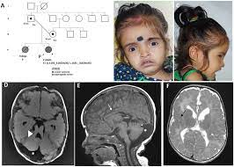
Joubert Syndrome 2
Rare, neurological, genetic disease.
Autosomal recessive.
-MTS (Mesial Temporal Sclerosis).
-Retinal dystrophy.
-Muscle weakness.
-Renal diseases.
-Endocrine abnormalities.
Notes:
TMEM216 GENİNİN KODLADIĞI TRANSMEMBRANE 216 PROTEİNİNDE MEYDANA GELEN MUTASYONLARIN EN BÜYÜK ÖLÇÜDE JOUBERT SYNDROME2 HASTALIĞINA YOL AÇTIĞINI BELİRLEDİK. JOUBERT SYNDROME2 BİR RARE GENETİC DİSEASEDİR. JOUBERT SENDROMU, MTS, HIPOTONI, RETINAL DISTROFI, SOLUNUM ANORMALLIKLERI, BÖBREK HASTALIKLARI VE ENDOKRIN ANORMALLIKLERI ILE KARAKTERIZE EDİLEBİLEN GENETIK OLARAK HETEROJEN OTOZOMAL RESESIF KALITIM MODELİNE SAHİP NÖROLOJİK BİR HASTALIKTIR.

Slide 7
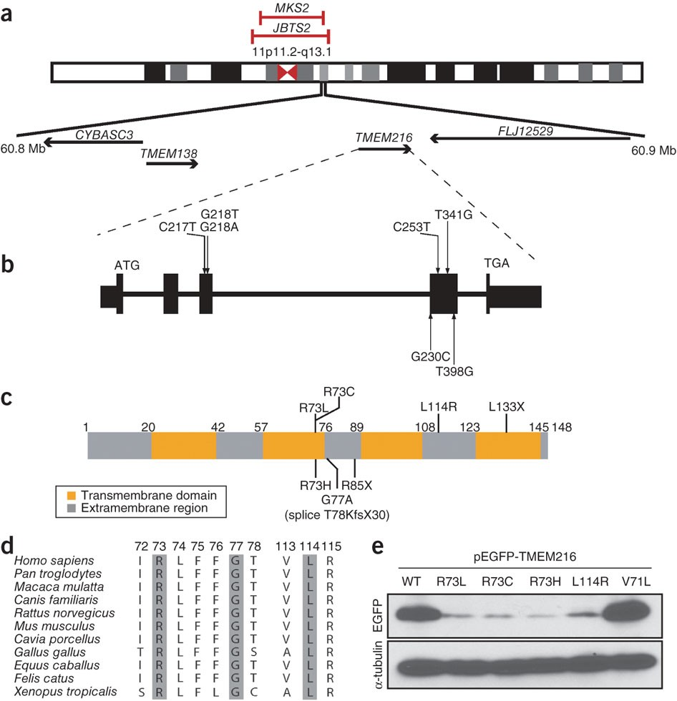
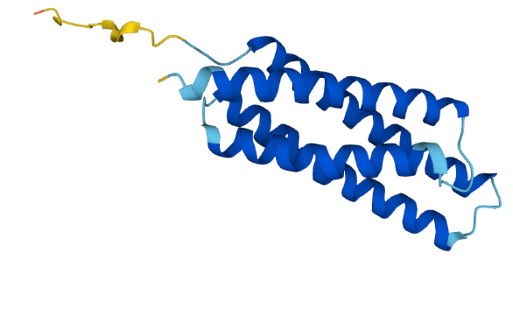
TMEM 216 Protein
TMEM 216 gene.
Cell communication and Signaling
87 amino acid & 2 transmembrane domain.
Notes:
TRANSMEMBRANE 216 PROTEİNİ TMEM216 GENİ TARAFINDAN KODLANAN BİR PROTEİNDİR. BU PROTEİN 87 AMİNO ASİT VE 2 TANE DOMAİNDEN OLUŞAN BİR TRANSMEMBRANE PROTEİNİDİR. TMEM 216 İNSANLARDA BİR PROTEİN CODİNG GENEDİR. TRASNMEMBRANE PROTEİNİ 216 ÇEŞITLI SINYAL YOLLARI VE DUYU FONKSIYONLARINDA YER ALAN SILYUMDA BULUNUR. TMEM216 PROTEİNİ HÜCRESEL TAŞIMA, SINYAL YOLLARI VE YAPISAL DESTEKTE ROL OYNAR. SILIALARLA ILIŞKILI PROTEINLER SILIYER FONKSIYON IÇIN ÇOK ÖNEMLIDIR VE BU PROTEINLERDEKI MUTASYONLAR, SILIA YAPISI VEYA FONKSIYONUNDAKI ANORMALLIKLER ILE KARAKTERIZE EDILEN BIR GRUP HASTALIK OLAN SILIOPATILERE (SİLYUMLARI ETKİLEYEN BÜTÜN HASTALIKLARIN GENEL ADI, JOUBERT SYNDROME 2 DE BİR SİLİOPATİ) YOL AÇABILIR.

Slide 8
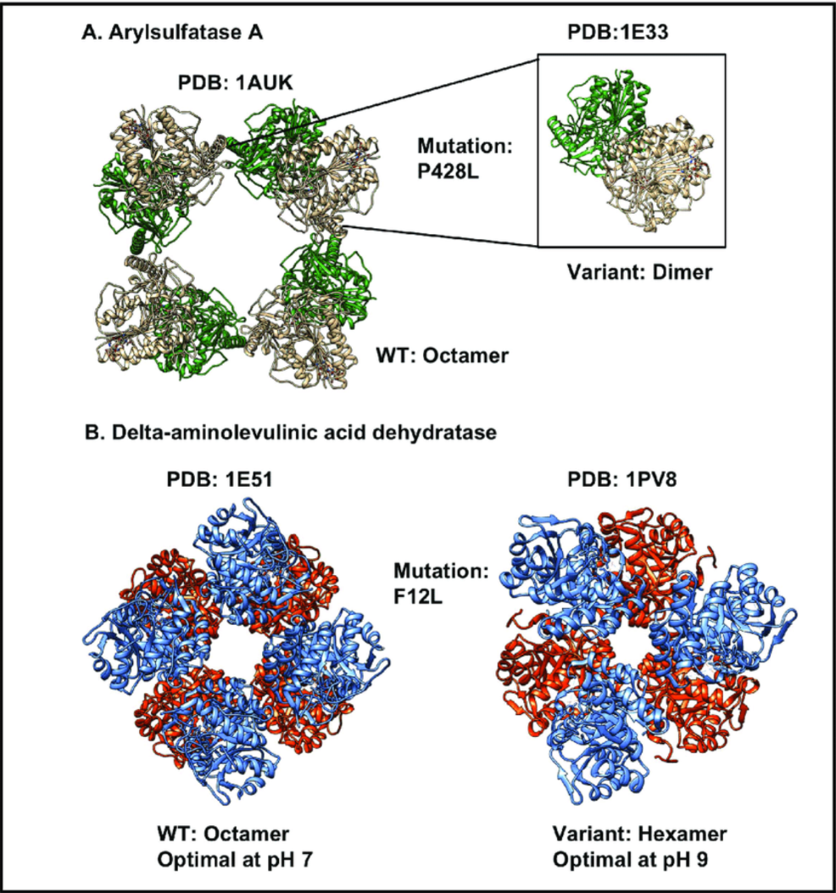
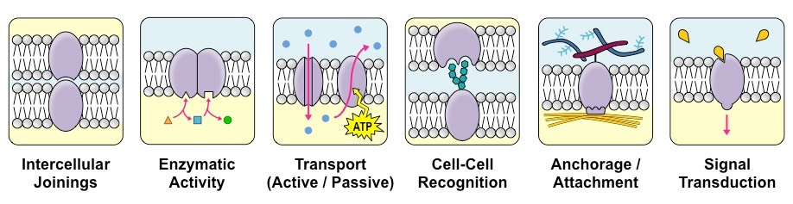
Transmembrane Proteins
Transportation, signaling, enzyme activity.
Notes:
TMEM 216 BİR TRANSMEMBRANE PROTEİNİDİR. TRANSMEMBRANE PROTEİNLERİNİN GENEL ÖZELLİKLERİ; TRANSPORTATİON, ENZİM AKTİVİTESİ (PERFORM BİOCHEMİCAL REACTİONS AT THE MEMBRANE), STRUCTURAL SUPPORT FOR CELLDİR.

Slide 9
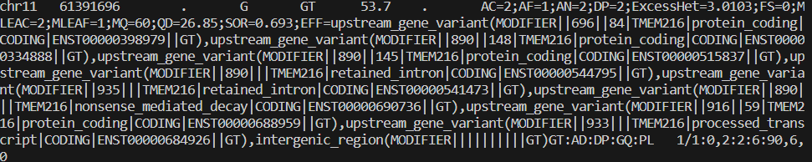
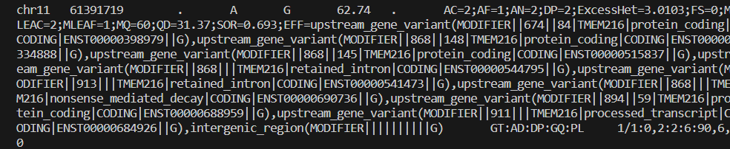
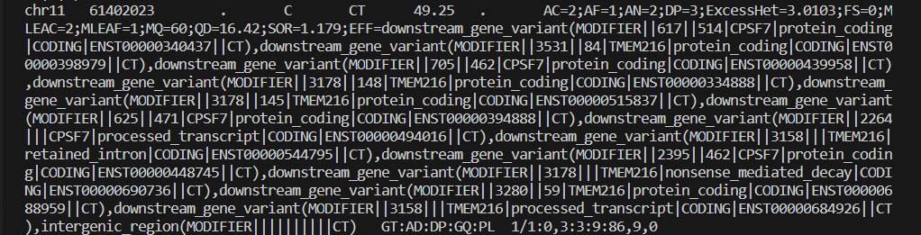
Are our variants pathogenic?
Notes:
We searched for the variants in TMEM216 from our data. We observed 7 different variant positions on chromosome 11. than we searched for the positions number of the mutations on clinvar in order to determine the variant. These 3 positions are part of the data also we could not find any information about these three positions on Clinvar database. So, the effects of these three mutations on the patient cannot be examined based on the clinvar data. This may mean that no research has been done on these variant positions yet.

Slide 10
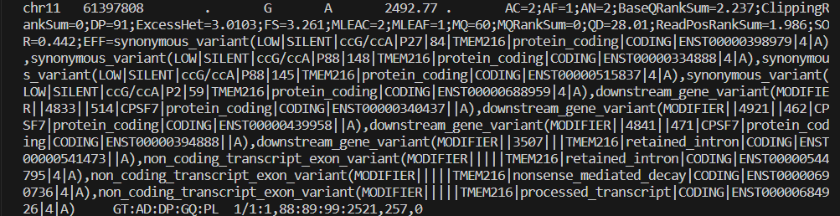
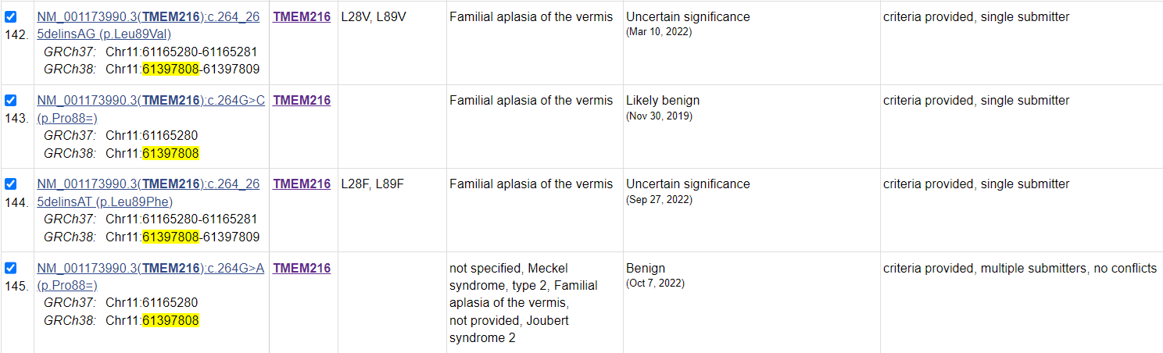
Notes:
We found 4 mutation information for this position in clinvar. But the only mutation that fits our data is the one at the bottom. Because the others are mutations that occurred at the same position but with different base changes. The mutation we observed in this table was determined to be benign.

Slide 11
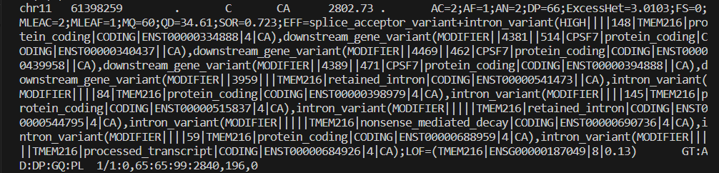
Notes:
The variant associated with the position here matches the position and base change information in our data. But it was again determined as a non-pathogenic mutation.

Slide 12
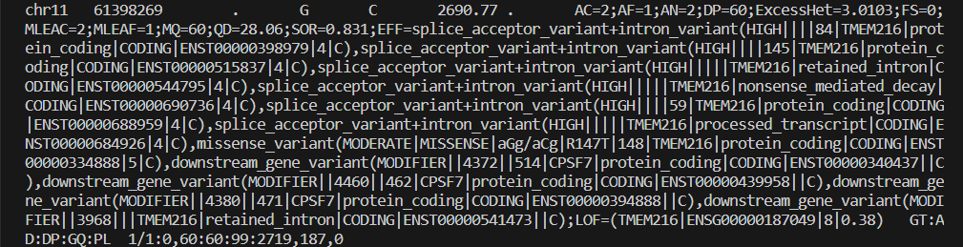
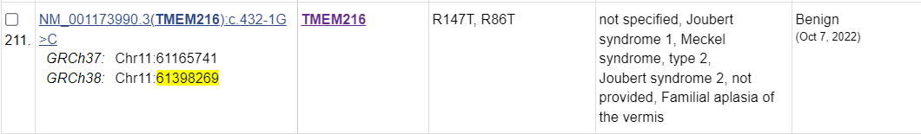
Notes:
The variant information in this and the next slide is the same as the previous one, the position and base change information match, but all of the variants here were determined to be benign.

Slide 13
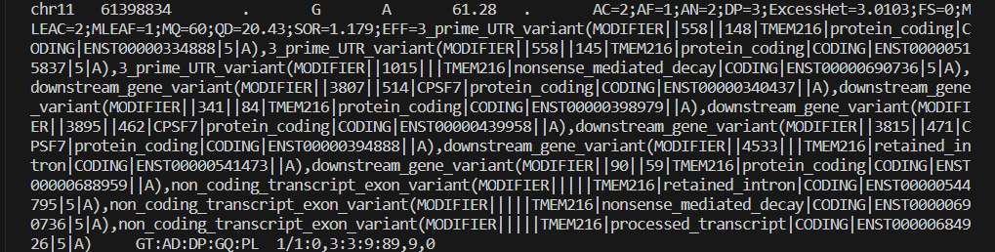
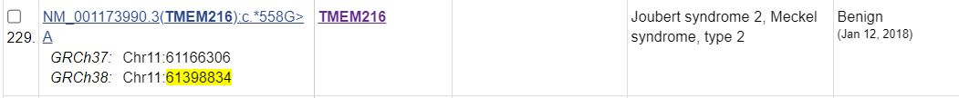
Notes:
So, as a result, all of the variants in the gene we chose which is TMEM216 were determined as non-pathogenic.

Slide 14
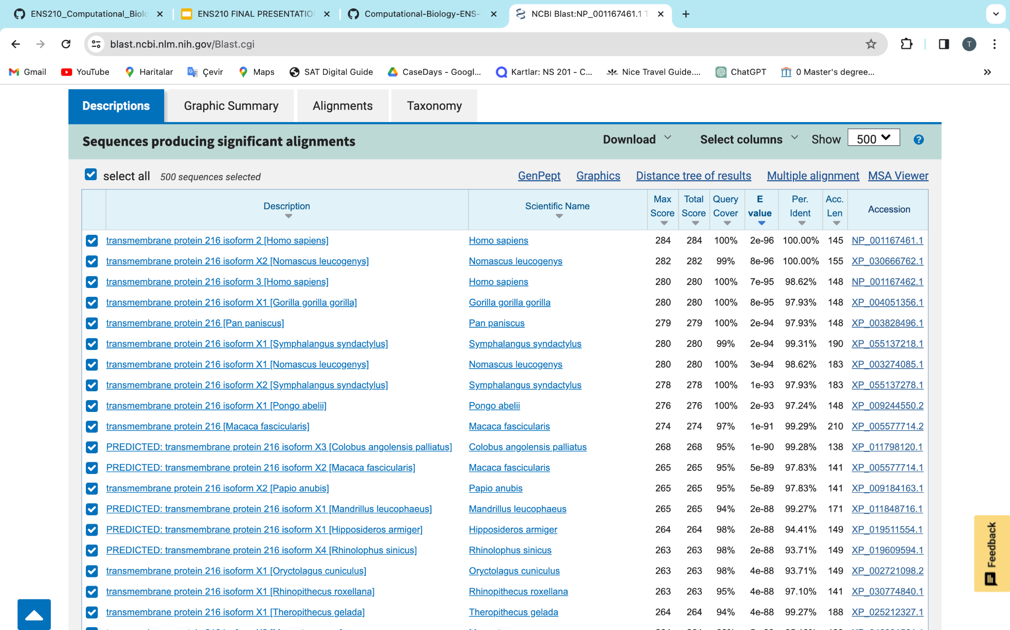
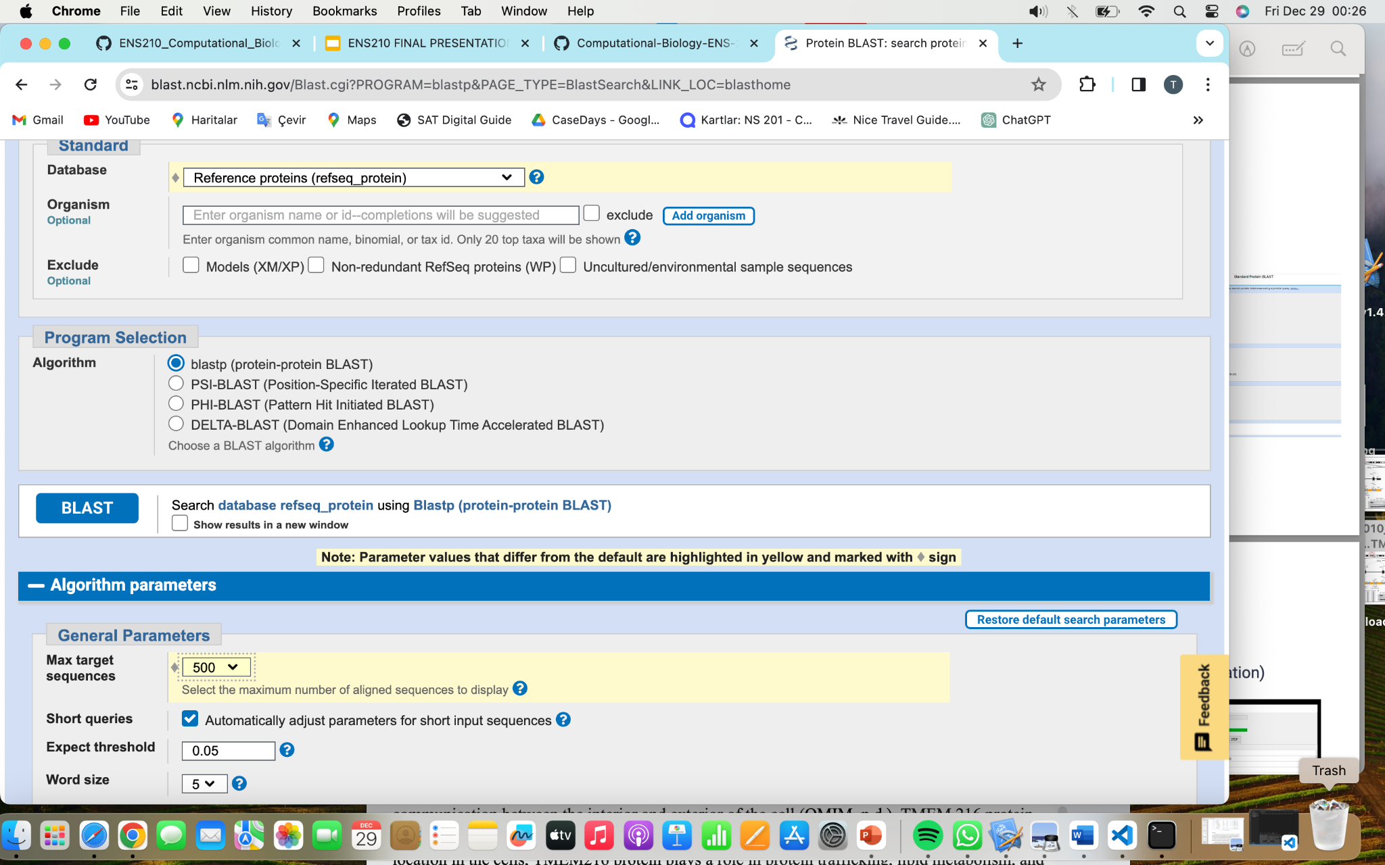
Homologous Sequence Search
BLASTp

Slide 15
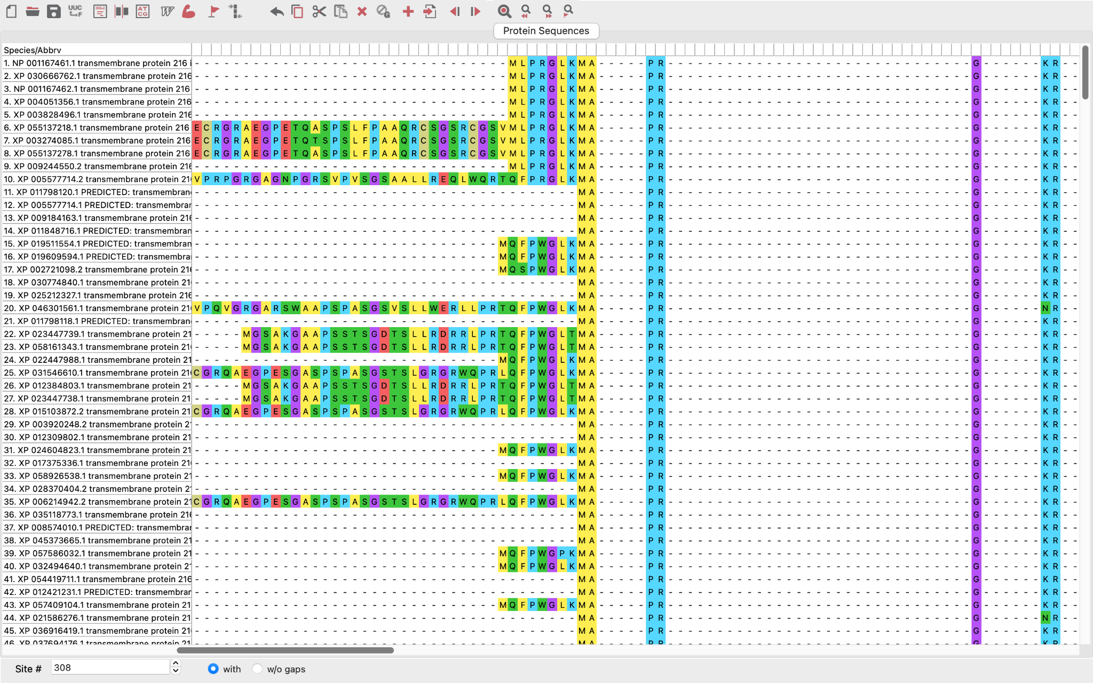
Multiple Sequence Alignment (MSA)
MEGAX
MUSCLE algorithm

Slide 16
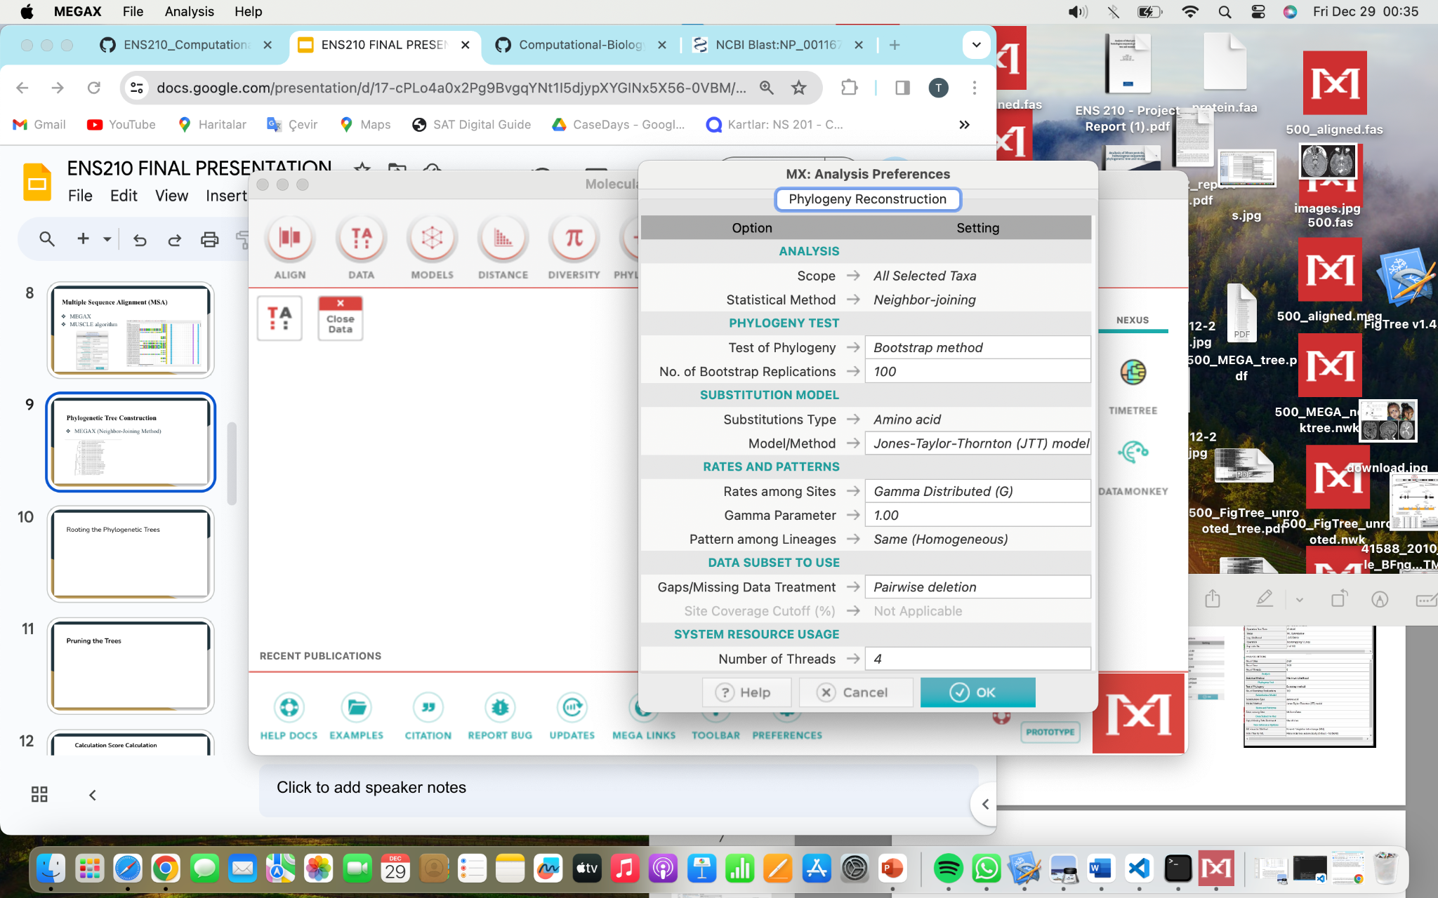
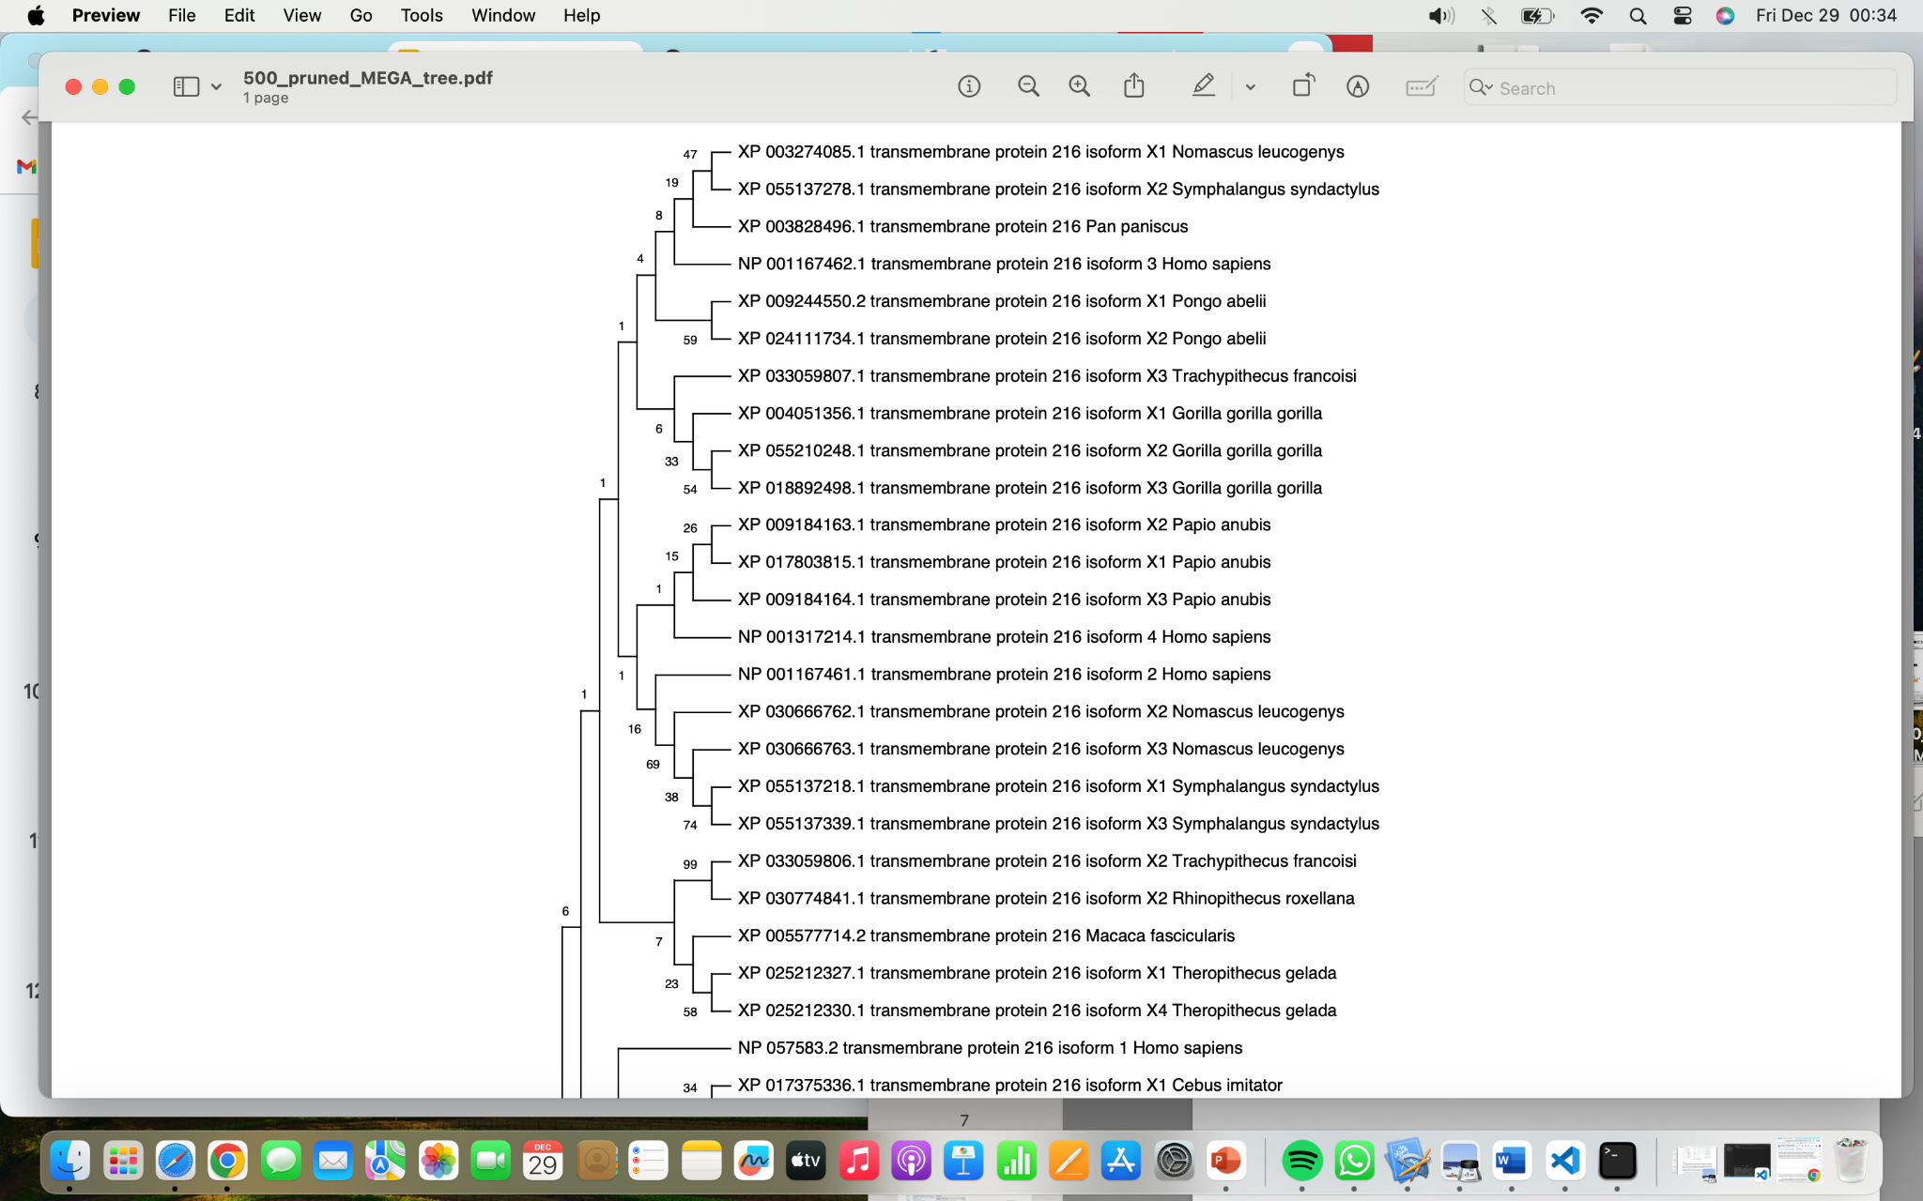
Phylogenetic Tree Construction
MEGAX (Neighbor-Joining Method)

Slide 17
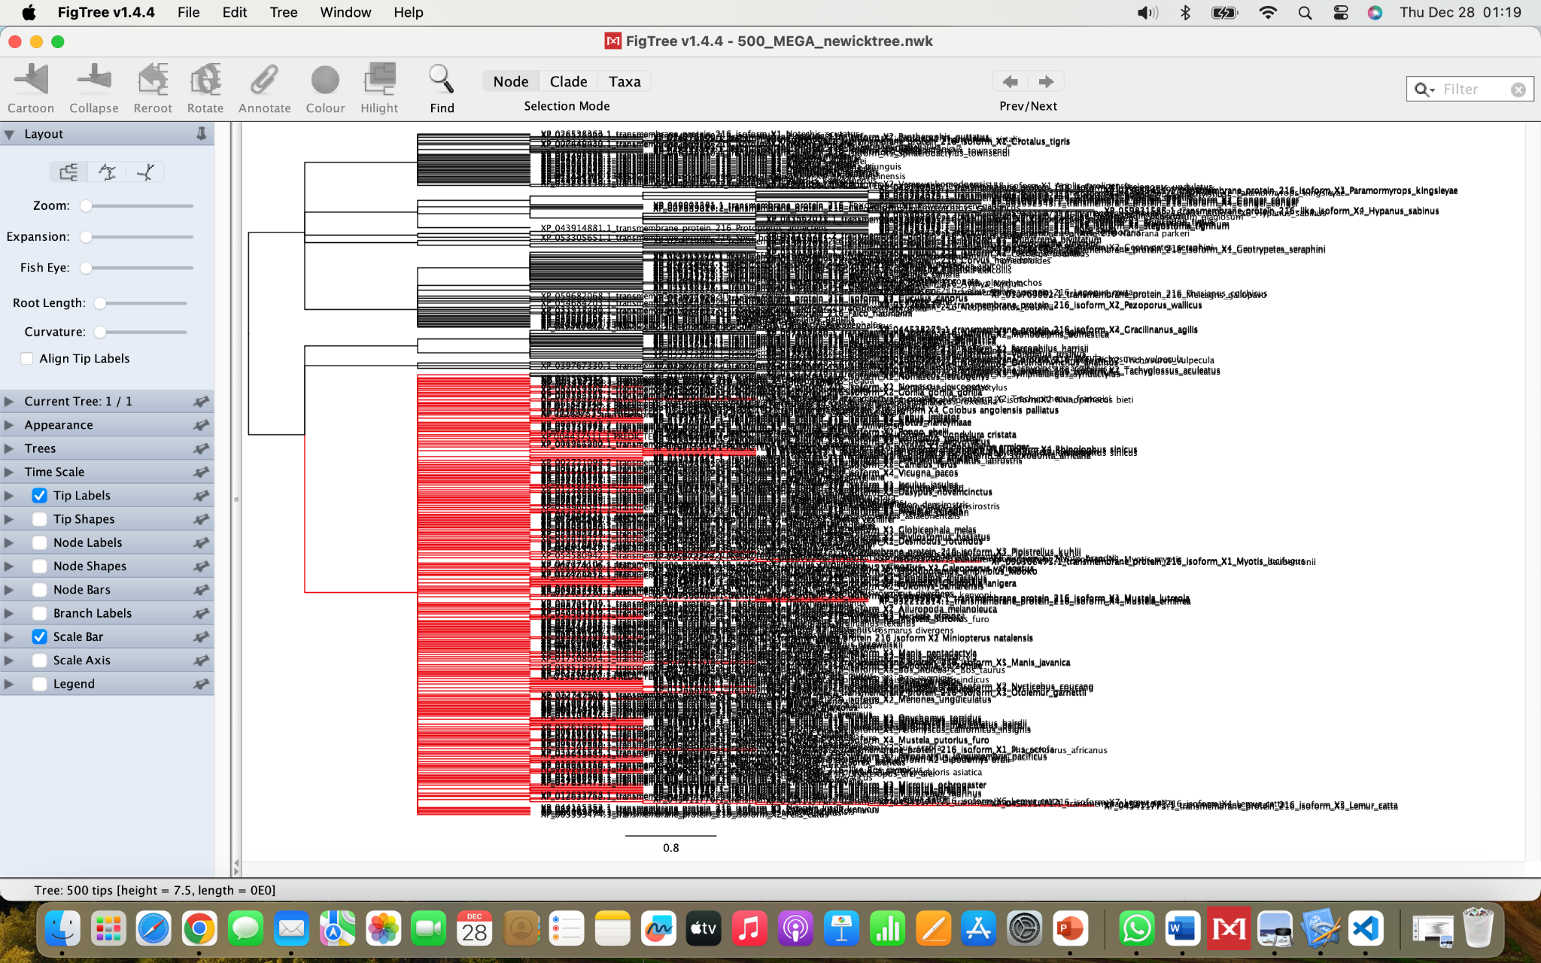
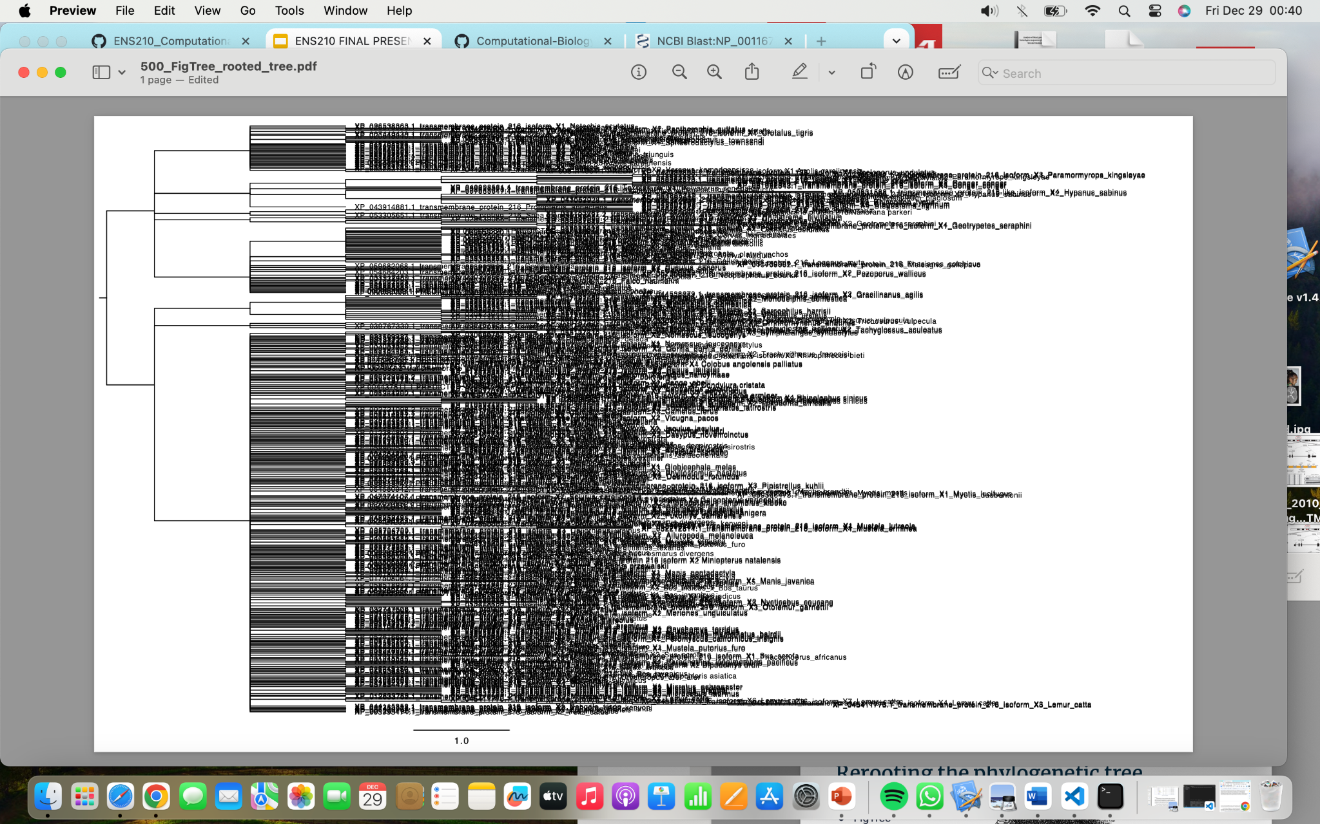
Rooting the Phylogenetic Trees
FigTree (Midpoint Rooting)
Phylogenetic tree of 500 sequences file

Slide 18
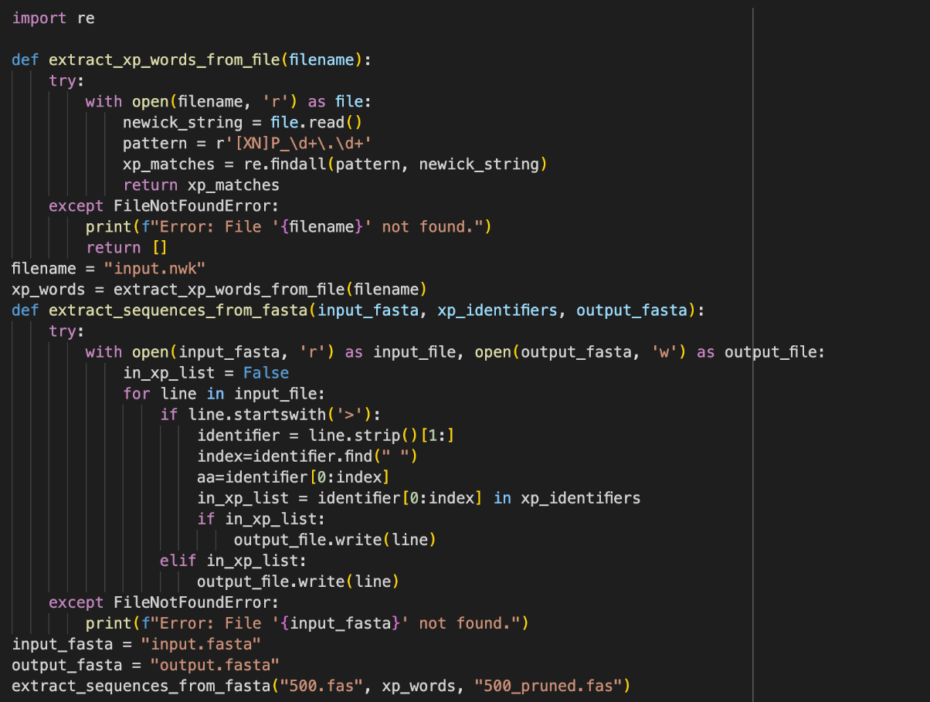
Obtaining the Fasta File of the Subtree
Python

Slide 19
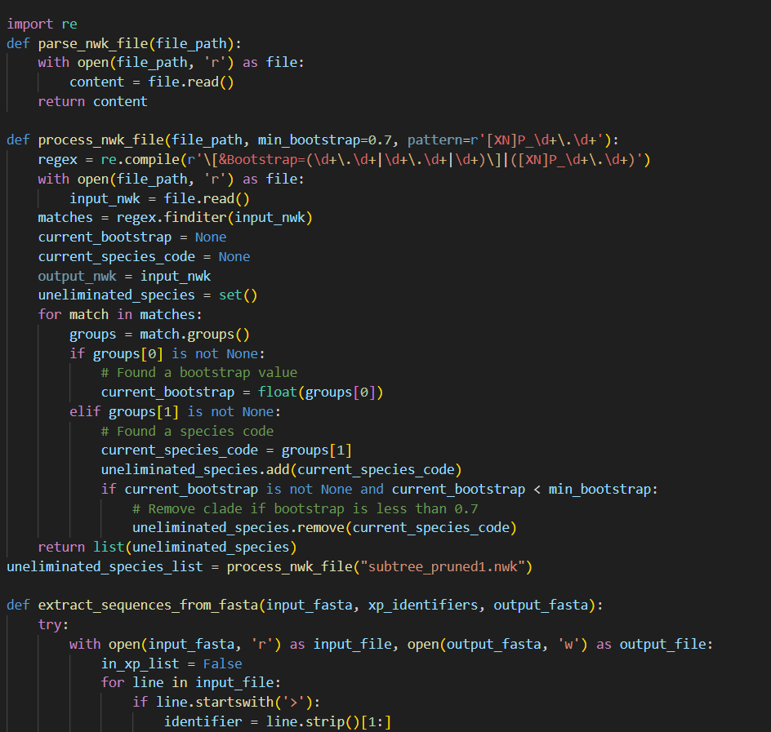
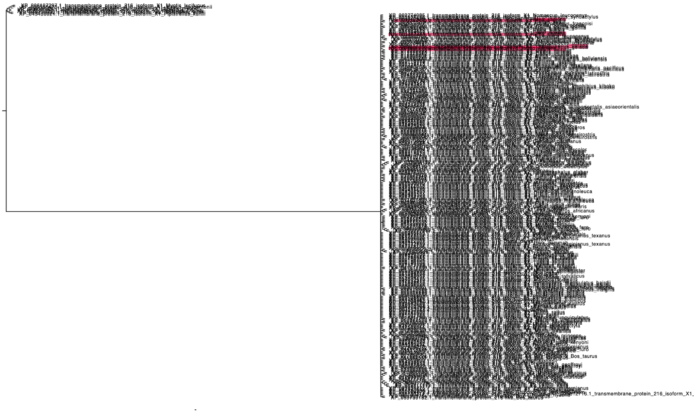
Rooting the Phylogenetic Trees and Second Subtree
FigTree (Midpoint Rooting)
Python
Phylogenetic tree of first subtree

Slide 20
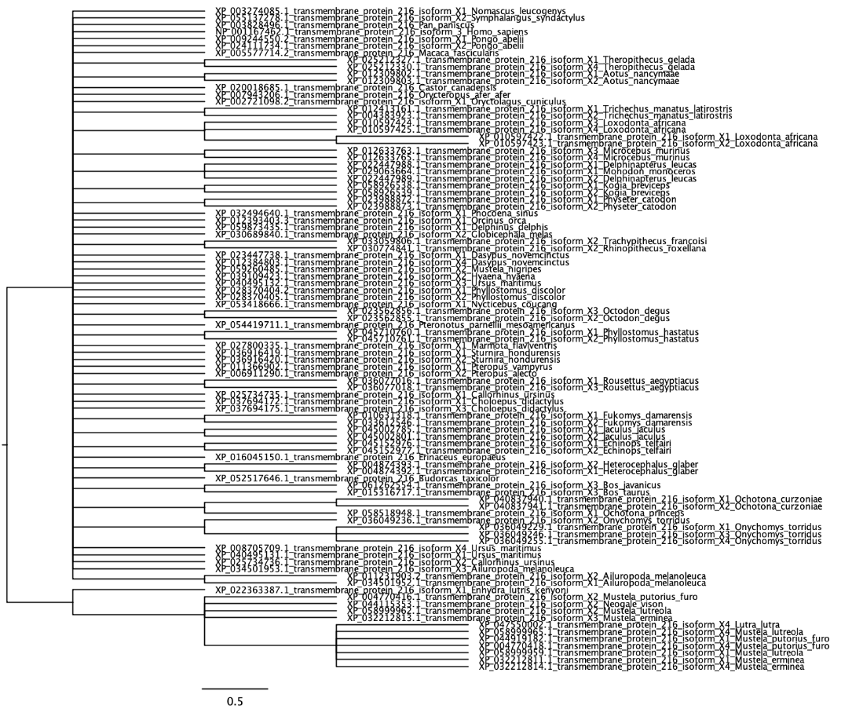
Rooting the Phylogenetic Trees
FigTree (Midpoint Rooting)
Phylogenetic tree of second subtree

Slide 21
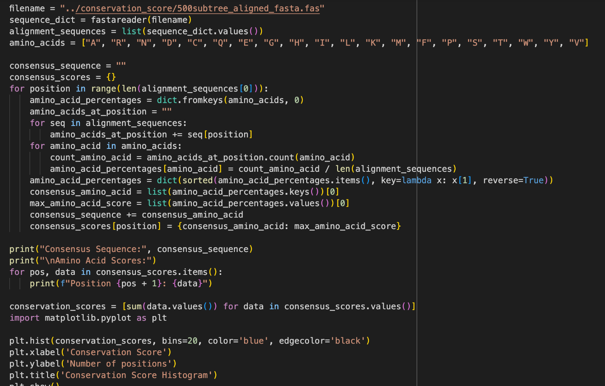
Conservation Score Calculation
Python

Slide 22
Mutation Analysis
Mutations were retrieved from three different sources;
Clinical Papers
Absolute pathogenic mutations were retrieved
ClinVar Database
Variation and phenotype relationship
GnomAD Database
Population Frequencies

Slide 23
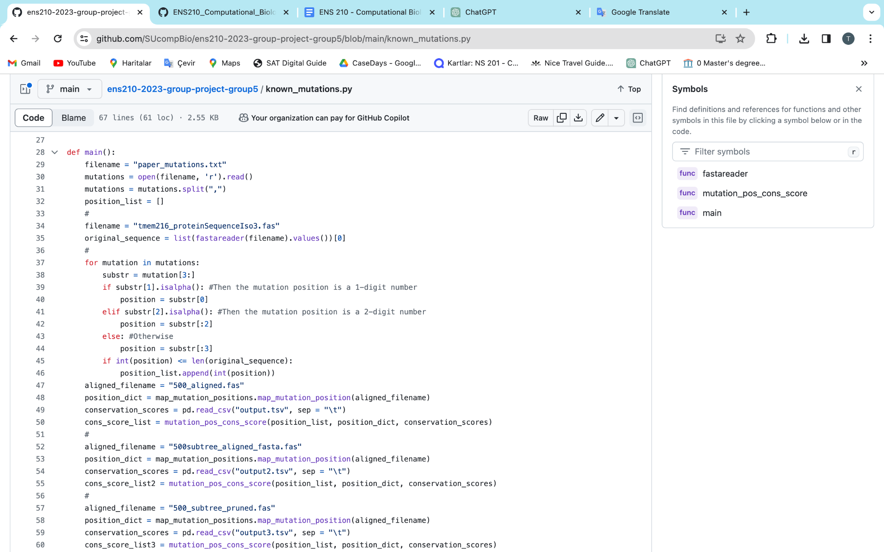
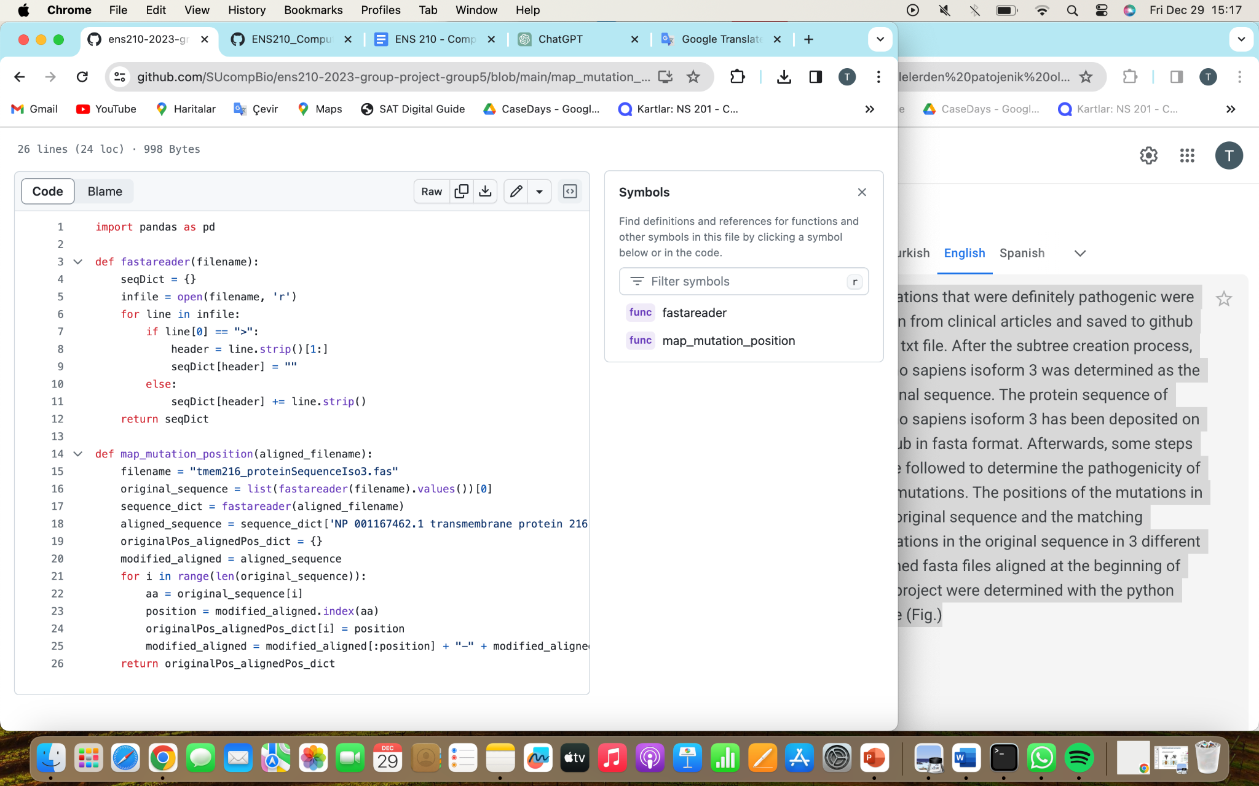
Mapping the Mutations and Calculating Threshold Values
Python
Mapping the mutations
Calculating Threshold Values

Slide 24
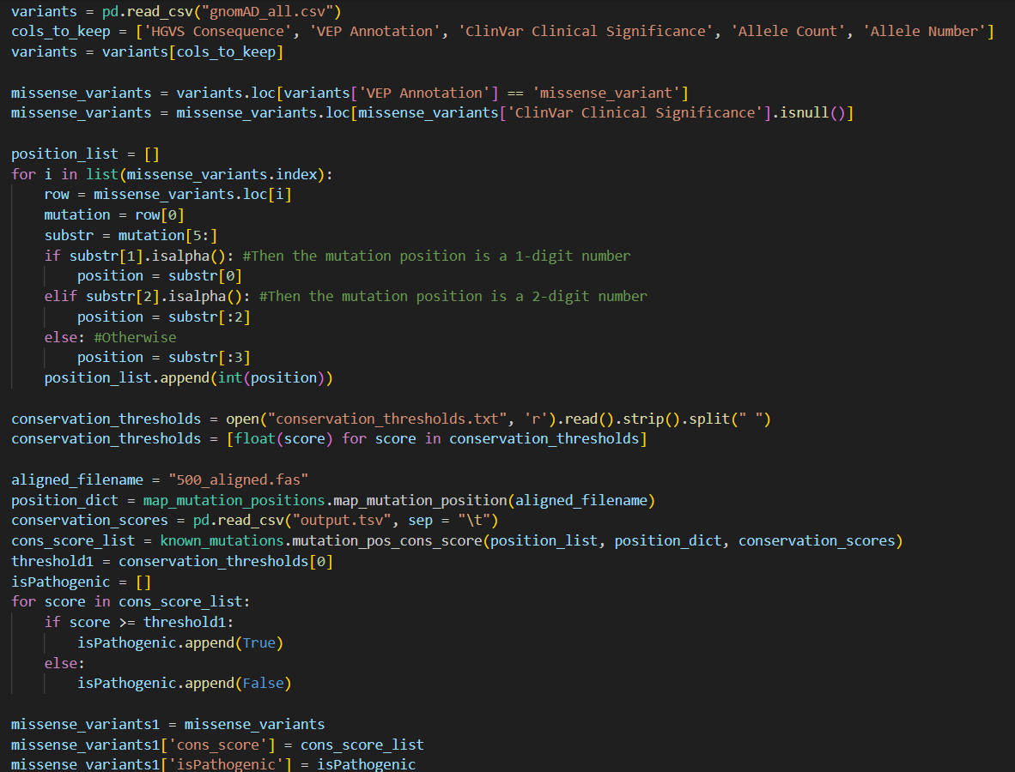
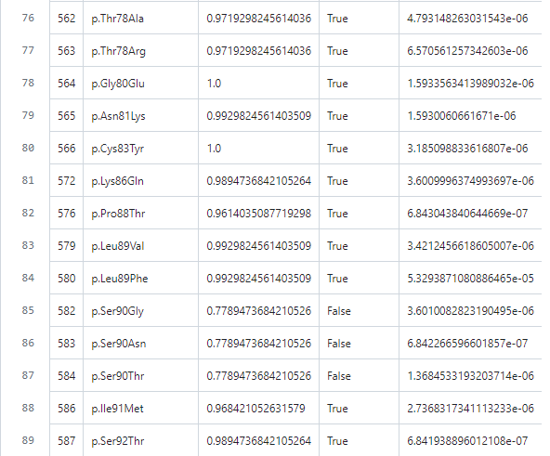
Classification/Variant Analysis of Variants in TMEM216 Gene
Python

Slide 25
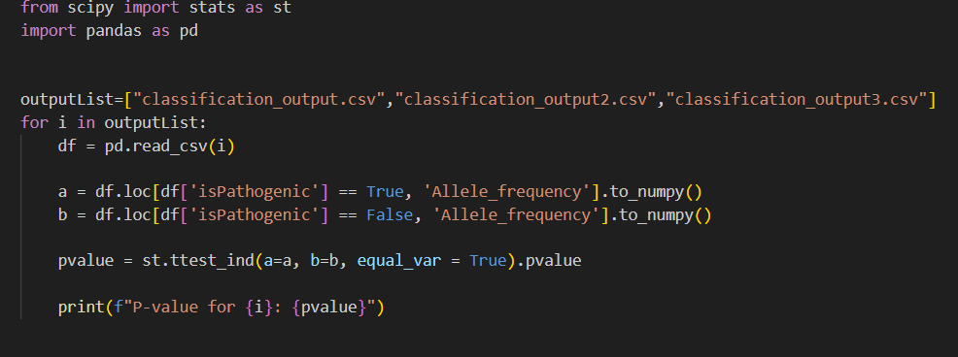
Statistical Testing: t-test
Python

Slide 26
500 Aligned Sequence

Slide 27
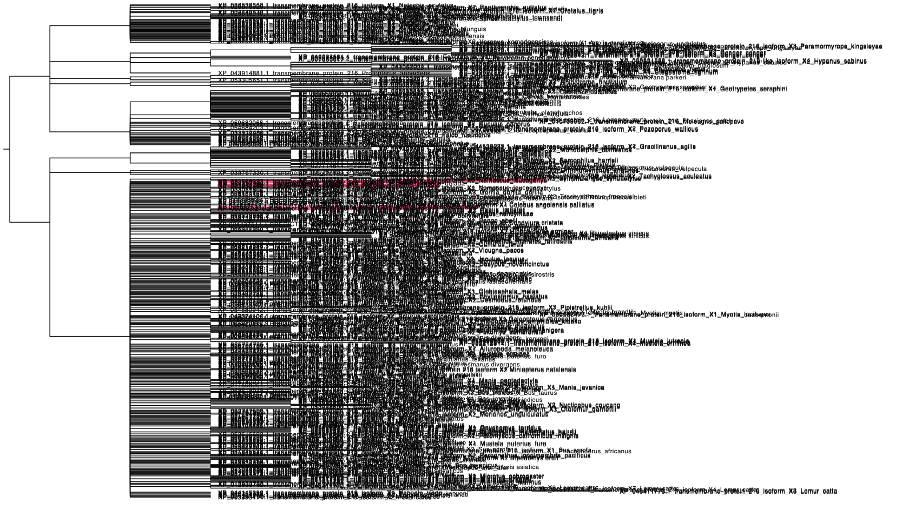
TMEM216 isoforms

Slide 28
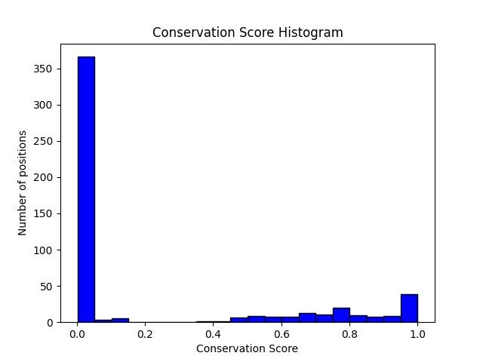
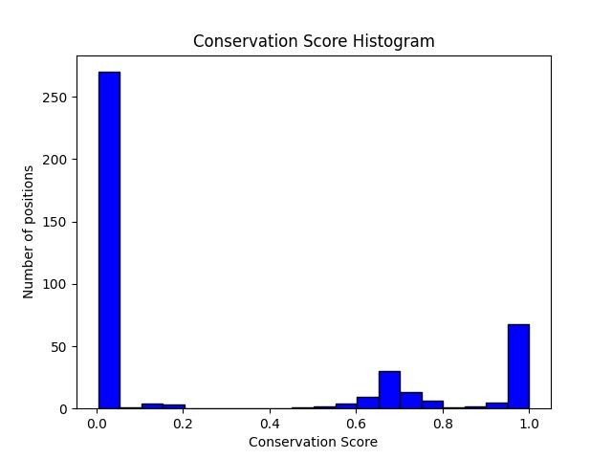
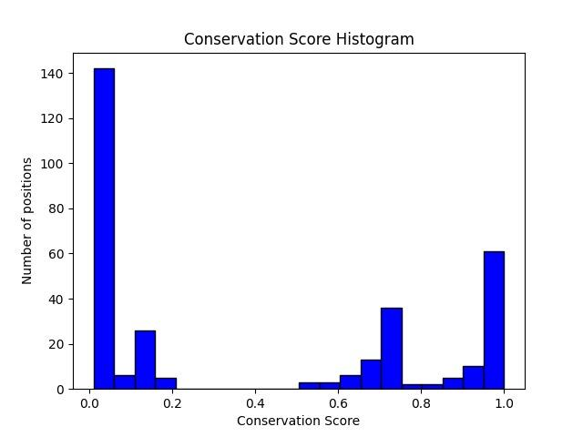
Conservation Score Distributions for Different Aligned Sequences
Distribution of 500 aligned sequences
Distribution of pruned aligned sequences
Distribution of second time pruned aligned sequences

Slide 29
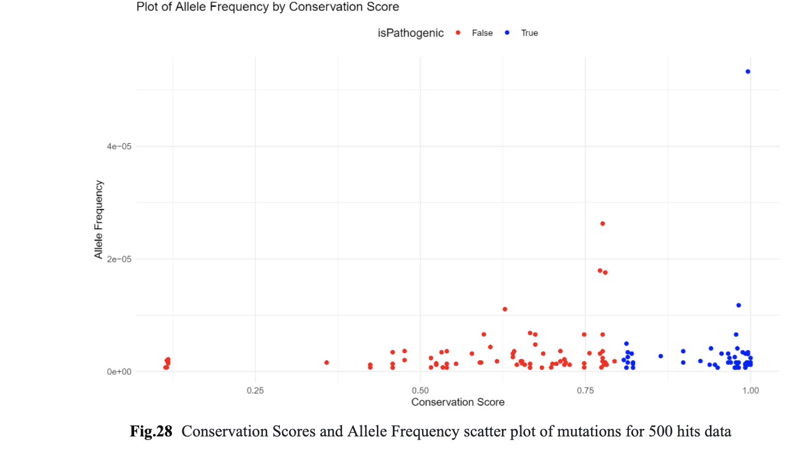

Slide 30
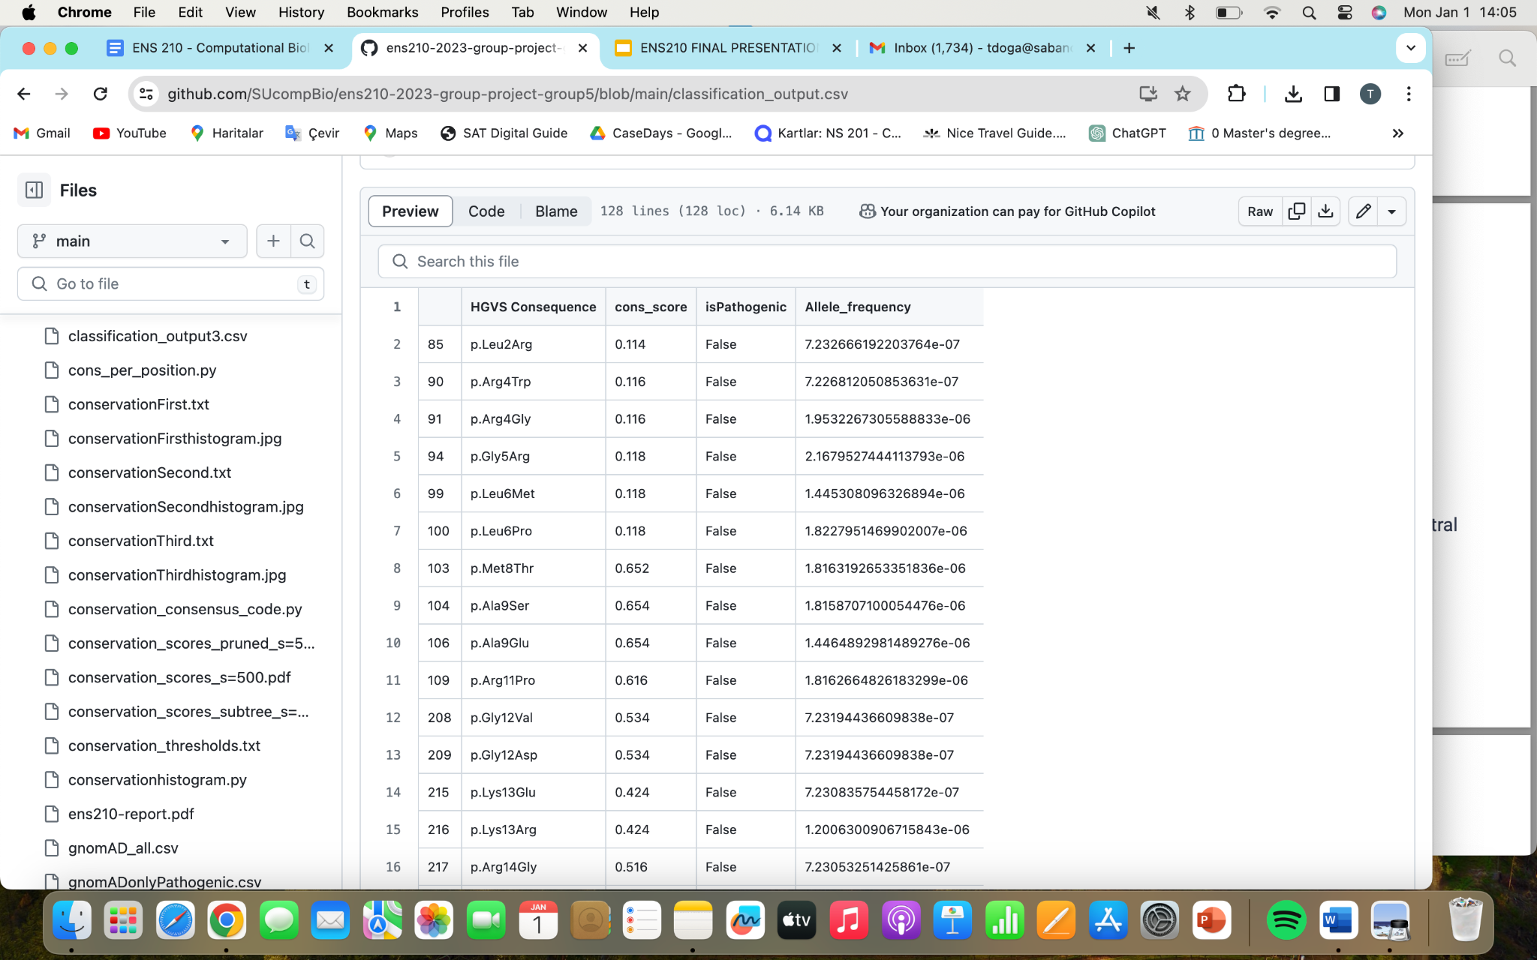
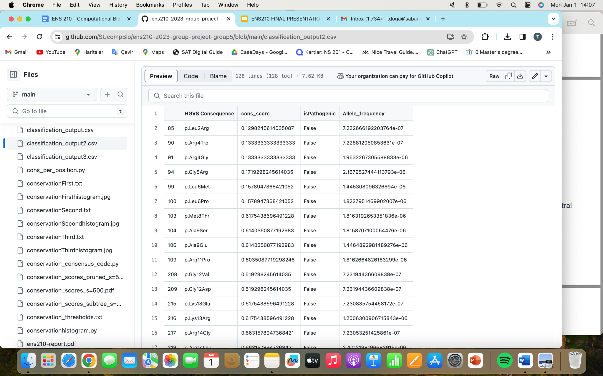
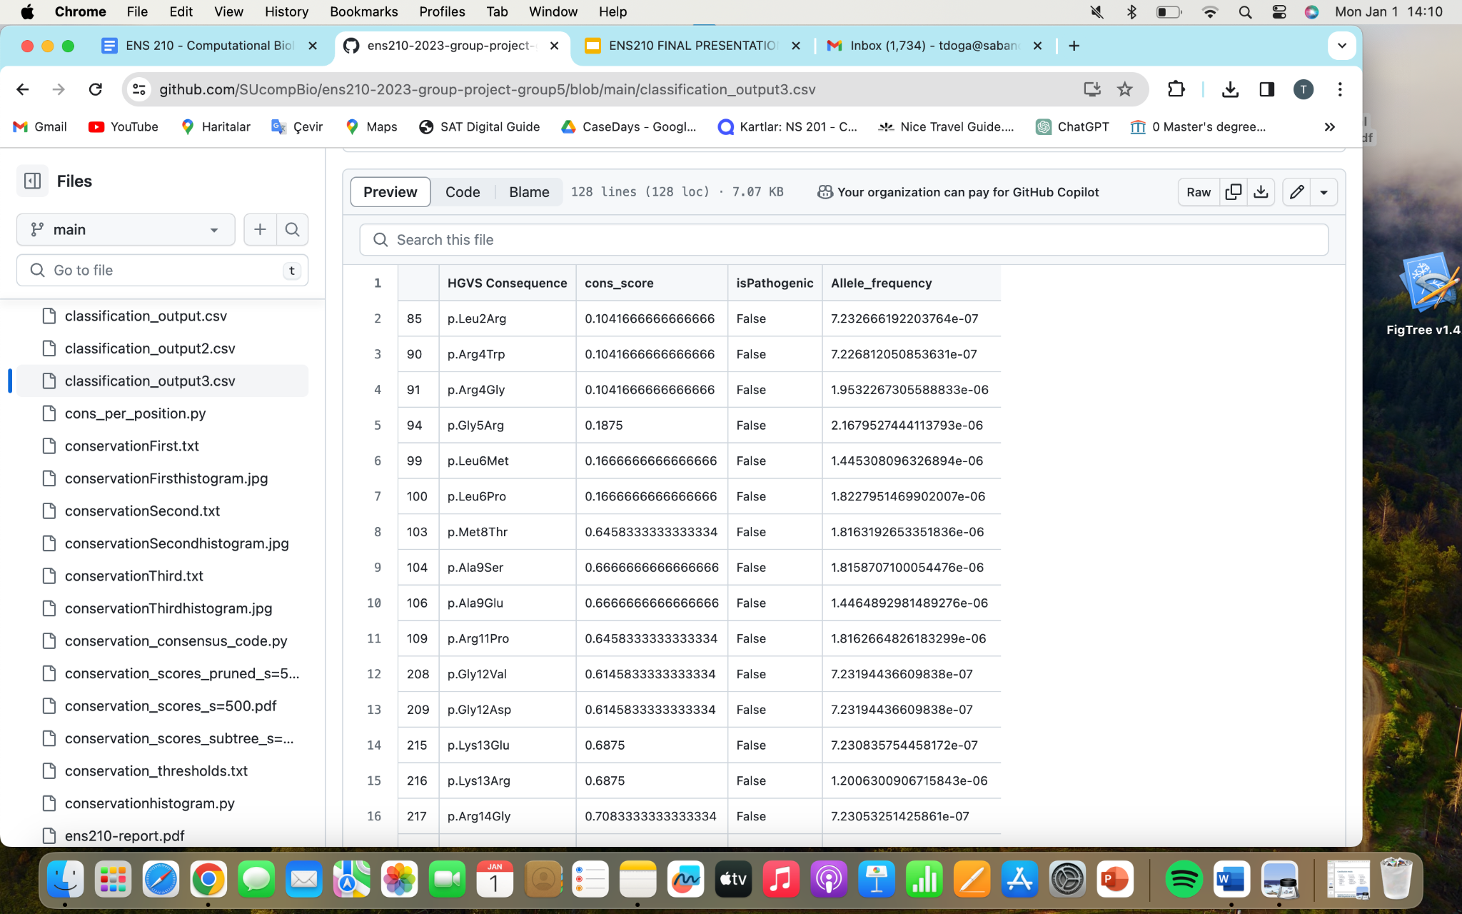
Classification Results
1.Output file
2.Output file
3.Output file
1.Threshold Value: 0.8074285714285713
2.Threshold Value: 0.8401002506265665
3.Threshold Value: 0.8705357142857143

Slide 31
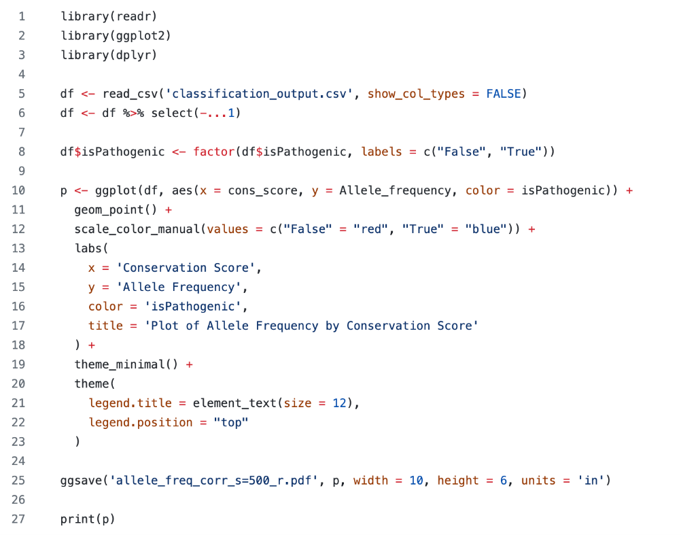
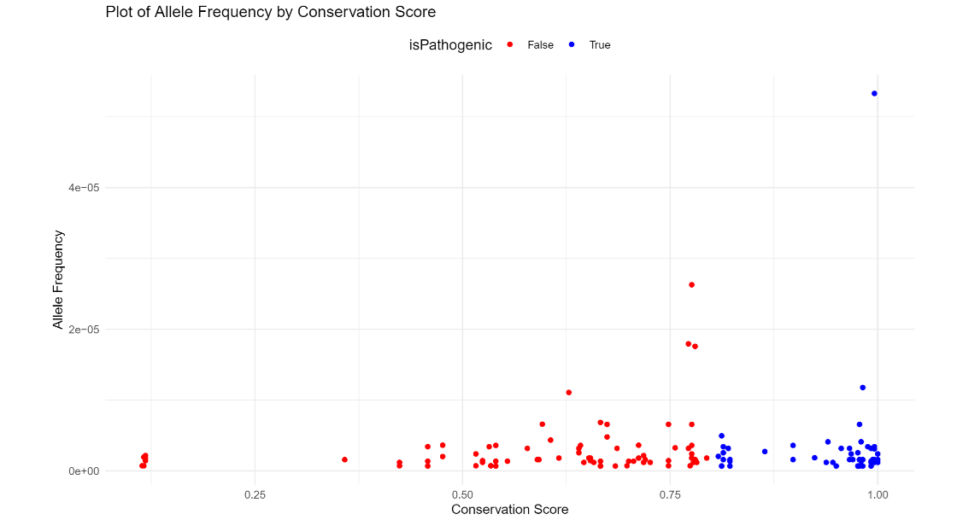
Conservation Score and Allele Frequency Plots
R Studio

Slide 32
Discussion
As the number of known pathogenic mutations increases, the classification of unknown mutations becomes more accurate.
As the genetic relevance of the sequences increases in a set of sequences, conservation scores and the threshold value also increase.
Number of mutations which identified as pathogenic and the classification thresholds are very close for the second and third data.
With the observation of p-values, there is no statistically significant difference in allele frequencies between pathogenic and nonpathogenic variants.
According to allele frequency scatter plot of mutations there is no negative correlation between conservation scores and allele frequencies.
Notes:
According to data from clinical papers 13 mutations are reported as pathogenic. Due to the insufficiency of the literature only 13 variant classified as pathogenic at the beginning. if there were more known pathogenic variants, the classification of unknown mutations would become more accurate.
Since the 500 hit data has more gap insertions than the subset tree data, variant positions overlap with more gap and the threshold value is lower than the other two data. Also, the conservation score of the 500 hits data is lower than the other 2 because of the decreased genetic relevance of the sequences.
Since the subset trees of 500 hits data, genetic relevance among sequences increased in 2. And 3. Data, due to high genetic relevance the thresholds are higher than the 1. One and also close to each other.
Since all of the p values are higher than 0.5 there is no statistically significant difference in allele frequencies between pathogenic and nonpathogenic variants.
According to allele frequency scatter plot of mutations we observe that there is negative correlation between conservation scores and allele frequencies.

Slide 33
Issues
Why sequence file of 5000 was not used?
Why sequence files of 100 and 250 were not used?
Why sequence file of 1000 was not used?
Notes:
Lastly I will talk about the issues that we encounter during the project. First of all we decided to take 100, 250, 500, 1000, 5000 hits data and we blasted all of them. Because the 5000 hits data file contains the paralogous sequences of homo sapiens TMEM216 protein we decided to exclude it from the analysis. For the remaining sequence files we performed BLASTp and we draw the trees on MEGAX. We thought that the analysis could give more accurate results with more sequences we excluded 100 and 250 hits data from the analysis due to insufficient data. Than we rerooted the 500 and 1000 hits data’s phylogenetic tree on FigTree. Due to the complexity and difficulty of analysis of 1000 hits data it was also excluded from the analysis and the final analysis was performed with 500 sequences file.

Slide 34
References
Agnihotry, S., Pathak, R. K., Singh, D. B., Tiwari, A., & Hussain, I. (2022). Protein structure prediction. Bioinformatics, 177–188.
https://doi.org/10.1016/b978-0-323-89775-4.00023-7
ClinVar. (n.d.). TMEM216[gene] - ClinVar - NCBI. https://www.ncbi.nlm.nih.gov/clinvar/?term=TMEM216%5Bgene%5D&redir=gene
Edvardson, S., Shaag, A., Zenvirt, S., Erlich, Y., Hannon, G. J., Shanske, A., Gomori, J. M., Ekstein, J., & Elpeleg, O. (2010c). Joubert
Syndrome 2 (JBTS2) in Ashkenazi Jews Is Associated with a TMEM216 Mutation. The American Journal of Human Genetics, 86(2), 294.
https://doi.org/10.1016/j.ajhg.2010.01.022
FigTree. (n.d.). http://tree.bio.ed.ac.uk/software/figtree/
GnomAD. (n.d.). gnomAD Browser. https://gnomad.broadinstitute.org/gene/ENSG00000187049?dataset=gnomad_r4

Slide 35
Hillis, D. M., & Bull, J. J. (1993). An empirical test of bootstrapping as a method for assessing confidence in phylogenetic analysis.
Systematic Biology, 42(2), 182–192. https://doi.org/10.1093/sysbio/42.2.182
Koichiro Tamura, Glen Stecher, and Sudhir Kumar (2020) MEGAX: Molecular Evolutionary Genetics Analysis version X. Molecular
Biology and Evolution 38:3022-3027. https://www.megasoftware.net/
OMIM. Transmembrane protein 216; TMEM216. (n.d.). https://www.omim.org/entry/613277
Parisi, M. (2017, June 29). Joubert Syndrome. GeneReviews - NCBI Bookshelf. https://www.ncbi.nlm.nih.gov/books/NBK1325/
Protein BLAST: search protein databases using a protein query. (n.d.).
https://blast.ncbi.nlm.nih.gov/Blast.cgi?PROGRAM=blastp&PAGE_TYPE=BlastSearch&LINK_LOC=blasthome
UniProt. (n.d.). https://www.uniprot.org/
U.S. National Library of Medicine. (2017, July 1). Joubert syndrome. MedlinePlus.
https://medlineplus.gov/genetics/condition/joubert-syndrome/#:~:text=Joubert%20syndrome%20typically%20has%20an,and%20symptoms%20of%20the%20condition

Slide 36
U.S. National Library of Medicine. (n.d.). Joubert syndrome 2 . National Center for Biotechnology Information.
https://www.ncbi.nlm.nih.gov/medgen/334114
U.S. National Library of Medicine. (n.d.). TMEM216[gene] - ClinVar - NCBI.
https://www.ncbi.nlm.nih.gov/clinvar/?term=TMEM216%5Bgene%5D&redir=gene
U.S. National Library of Medicine. (n.d.). TMEM216 transmembrane protein 216 [homo sapiens (human)] . National Center
for Biotechnology Information. https://www.ncbi.nlm.nih.gov/gene/51259
U.S. National Library of Medicine. (2021, March 26). What are proteins and what do They do?. MedlinePlus.
https://medlineplus.gov/genetics/understanding/howgeneswork/protein/
Valente, E. M. et.al.(2010). Mutations in TMEM216 perturb ciliogenesis and cause Joubert, Meckel and related syndromes.
Nature Genetics, 42(7), 619–625. https://doi.org/10.1038/ng.594

